Slide 1
Software Engineering I
Dr. Elham Mahmoudzadeh
Isfahan University of Technology
mahmoudzadeh@iut.ac.ir
2021

Slide 2
Chapter 6 Behavioral modeling(II)

Slide 3
Steps(I)
Preparing proposal
Requirements determination
User story
Abstract Business Process Modelling
Analysis
Functional Modelling
Structural Modelling
Behavioral Modelling

Slide 4
Steps(II)
Design
Optimization
Database Management
User Interface
Physical Architecture

Slide 5
Behavioral model
Describe the internal dynamic aspects of an information system that supports the business processes in an organization.
During analysis, behavioral models describe what the internal logic of the processes is without specifying how the processes are to be implemented.
Later, in the design and implementation phases, the detailed design of the operations contained in the object is fully specified.

Slide 6
Inputs
Use business process and functional models to describe the functional or external behavioral view of an information system.
Use structural models to depict the internal structural or static view of an information system.

Slide 7
Types of behavioral models
Behavioral models used to represent the underlying details of a business process portrayed by a use-case model, for example in UML, interaction diagrams (sequence and communication).
Interaction diagrams allow the analyst to model the distribution of the behavior of the system over the actors and objects in the system.
Behavioral model is used to represent the changes that occur in the underlying data, for example in UML, behavioral state machines.

Slide 8
Focus on what the dynamic view of the evolving system is
and
not on how the dynamic aspect of the system will be implemented

Slide 9
Communication Diagrams
Communication diagrams, like sequence diagrams, essentially provide a view of the dynamic aspects of an object-oriented system.
Show how the members of a set of objects collaborate to implement a use case or a use-case scenario.
Used to model all the interactions among a set of collaborating objects.
A communication diagram can portray how dependent the different objects are on one another.
A communication diagram is essentially an object diagram that shows message-passing relationships instead of aggregation or generalization associations.

Slide 10
Communication Dia. vs. Sequence Dia.
Communication diagrams emphasize the flow of messages through a set of objects, whereas the sequence diagrams focus on the time ordering of the messages being passed.
To understand the flow of control over a set of collaborating objects or to understand which objects collaborate to support business processes, a communication diagram can be used.
For time ordering of the messages, a sequence diagram should be used.
In some cases, both can be used to more fully understand the dynamic activity of the system.

Slide 11
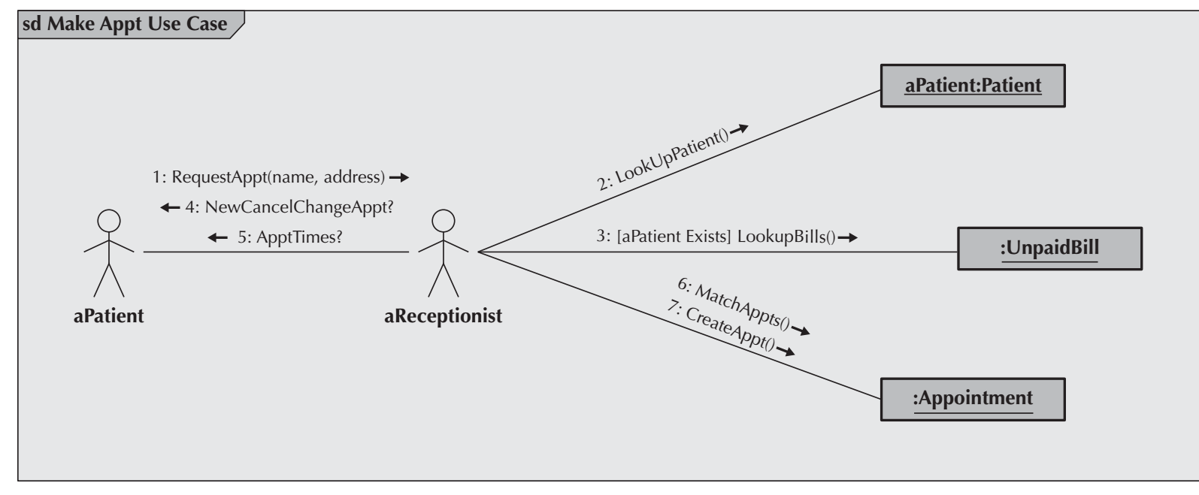
An example

Slide 12
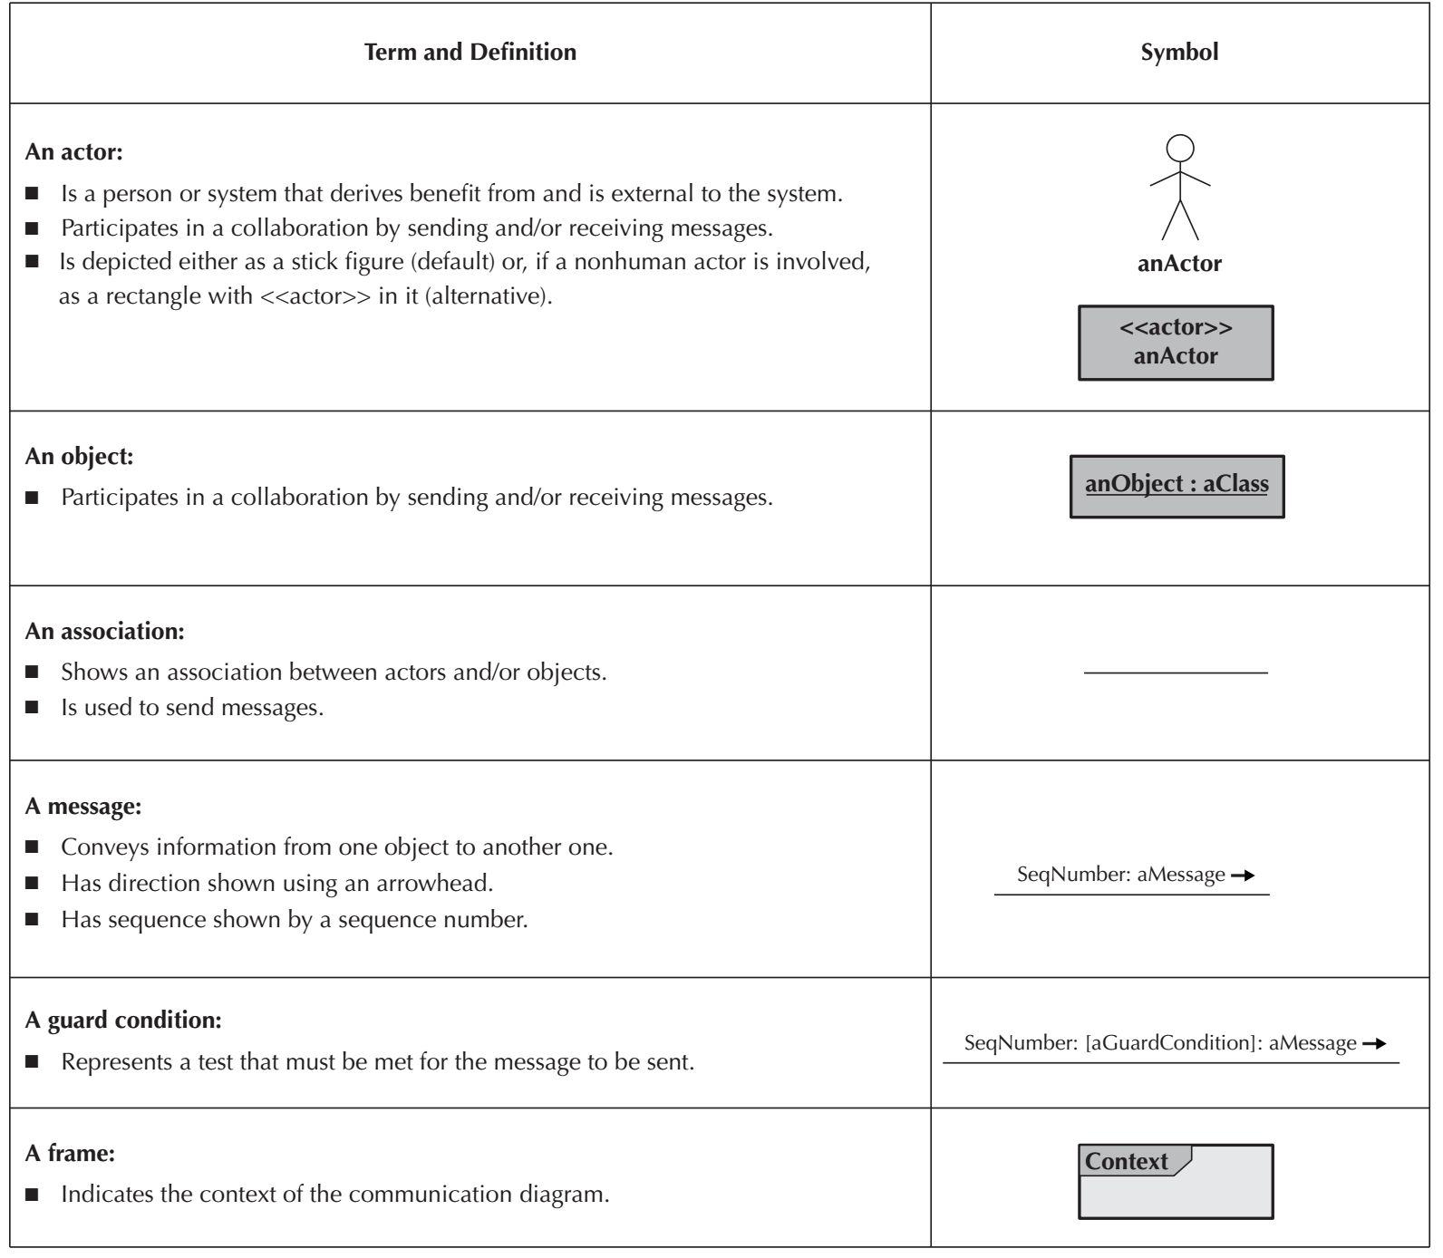
Elements of a Communication Diagram

Slide 13
Difference between Communication Dia. And Sequence Dia.
Unlike the sequence diagram, the communication diagram does not have a means to explicitly show an object being deleted or created. It is assumed that when a delete, destroy, or remove message is sent to an object, it will go out of existence, and a create or new message will cause a new object to come into existence.
Another difference between the two interaction diagrams is that the communication diagram never shows returns from message sends, whereas the sequence diagram can optionally show them.

Slide 14
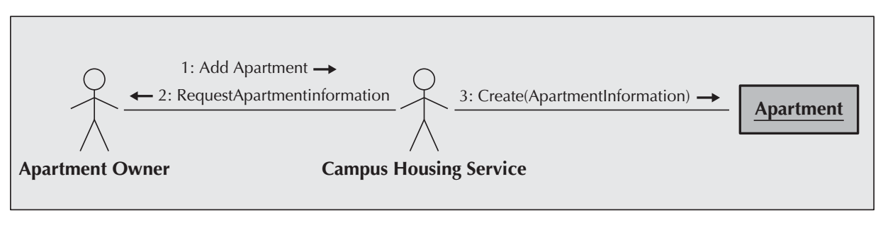
Communication Diagram for the Add Apartment Use Case

Slide 15
Behavioral State Machines
Some of the classes in the class diagrams represent a set of objects that are quite dynamic in that they pass through a variety of states over the course of their existence.
A behavioral state machine is a dynamic model that shows the different states through which a single object passes during its life in response to events, along with its responses and actions.
Typically, behavioral state machines are not used for all objects; rather, behavioral state machines are used with complex objects to further define them and to help simplify the design of algorithms for their methods.
The behavioral state machine shows the different states of the object and what events cause the object to change from one state to another.
Behavioral state machines should be used to help understand the dynamic aspects of a single class and how its instances evolve over time, Unlike interaction diagrams that show how a particular use case or use-case scenario is executed over a set of classes.

Slide 16
State
The state of an object is defined by the value of its attributes and its relationships with other objects at a particular point in time.
The attributes or properties of an object affect the state that it is in;
Not all attributes or attribute changes will make a difference.
Is a set of values that describes an object at a specific point in time and represents a point in an object’s life in which it satisfies some condition, performs some action, or waits for something to happen.

Slide 17
Event
An event is something that takes place at a certain point in time and changes a value or values that describe an object, which, in turn, changes the object’s state.
It can be a designated condition becoming true, the receipt of the call for a method by an object, or the passage of a designated period of time.

Slide 18
Transition
A transition is a relationship that represents the movement of an object from one state to another state.
Some transitions have a guard condition. A guard condition is a Boolean expression that includes attribute values, which allows a transition to occur only if the condition is true.
An object typically moves from one state to another based on the outcome of an action triggered by an event.

Slide 19
Action and Activity
An action is an atomic, non-decomposable process that cannot be interrupted. From a practical perspective, actions take zero time, and they are associated with a transition.
In contrast, an activity is a non-atomic, decomposable process that can be interrupted. Activities take a long period of time to complete, and they can be started and stopped by an action.

Slide 20
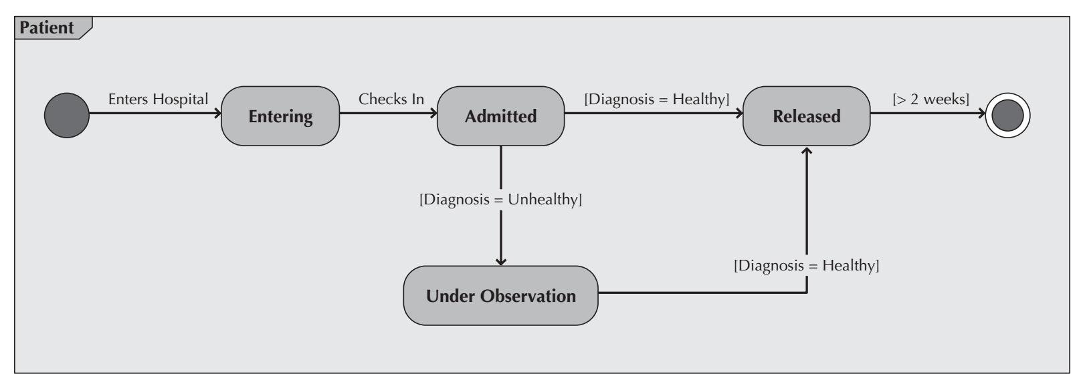
An example

Slide 21
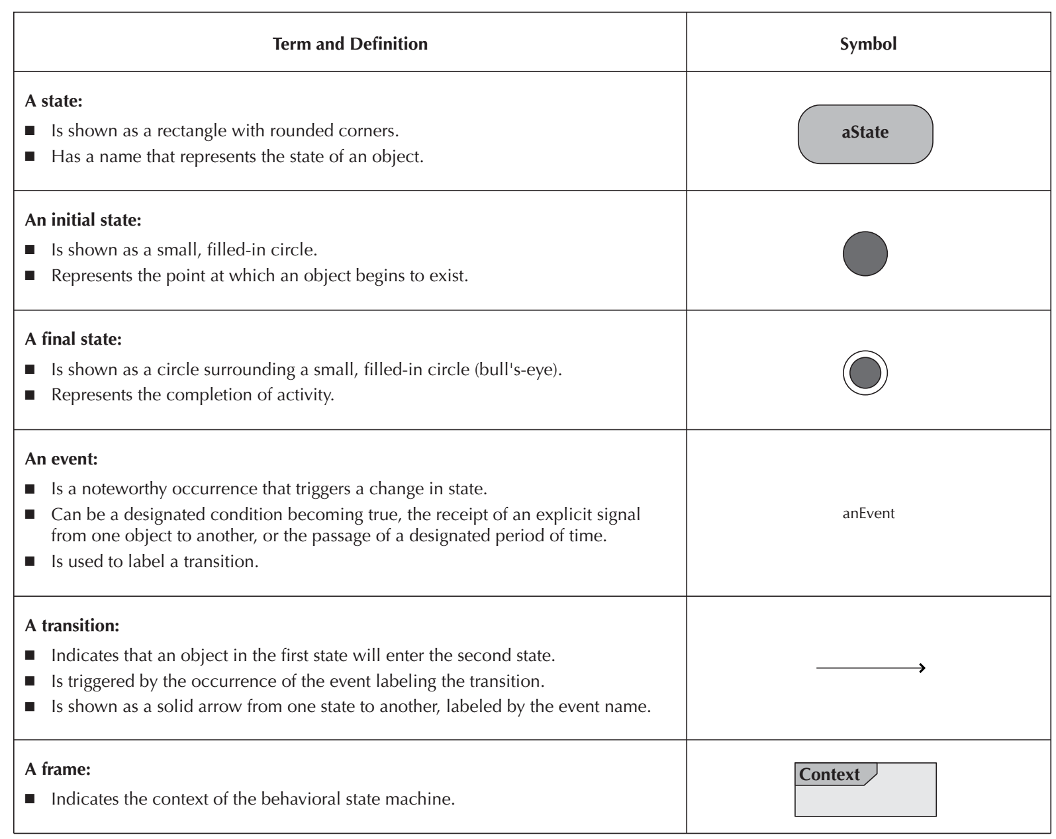
Elements of a Behavioral State Machine

Slide 22
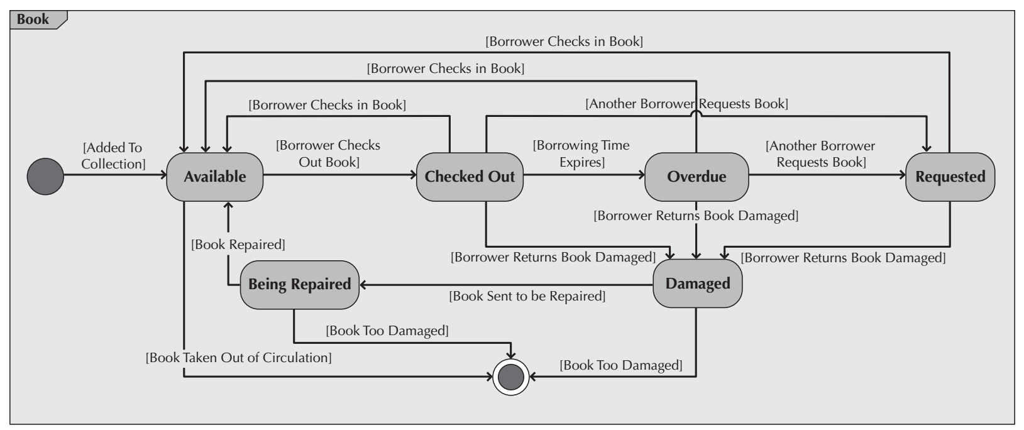
Behavioral State Machine for an Instance of the Book Class in the Library Book Collection Management System

Slide 23
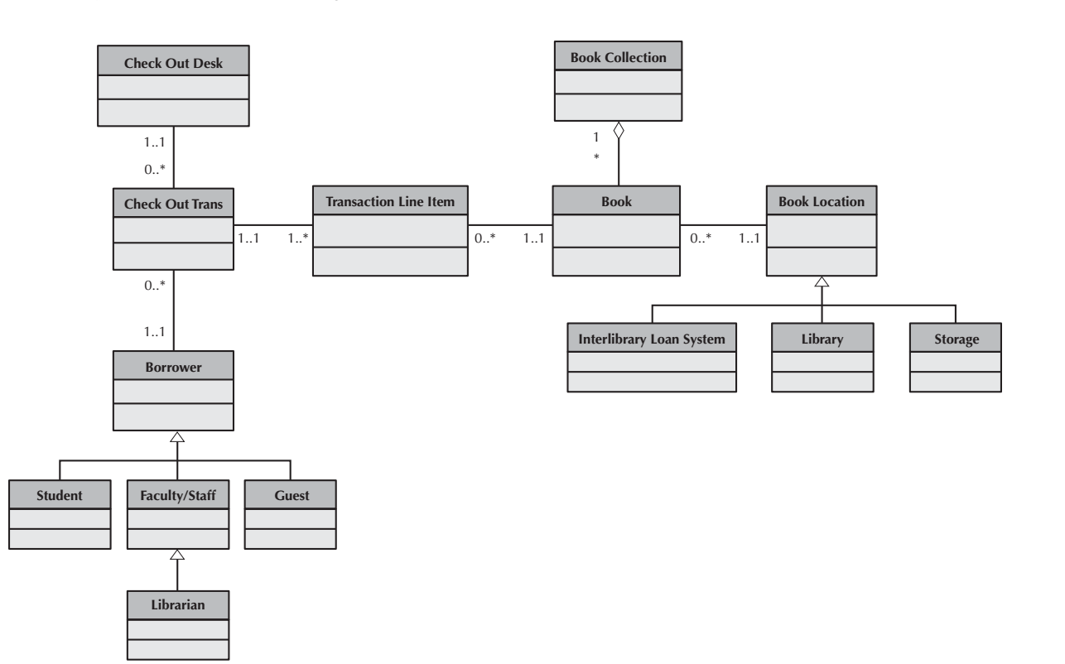
Class Diagram for the Library Book Collection Management System

Slide 24
Verifying and Validating The Behavioral Models
First, every actor and object included on a sequence diagram must be included as an actor and an object on a communication diagram, and vice versa.
Second, every message that is included on a sequence diagram must appear as a message on an association in the corresponding communication diagram, and vice versa.

Slide 25
Verifying and Validating The Behavioral Model(Cnt’d)
Third, if a guard condition appears on a message in the sequence diagram, there must be an equivalent guard condition on the corresponding communication diagram, and vice versa.
Fourth, the sequence number included as part of a message label in a communications diagram implies the sequential order in which the message will be sent. Therefore, it must correspond to the top-down ordering of the messages being sent on the sequence diagram.
Fifth, all transitions contained in a behavior state machine must be associated with a message being sent on a sequence and communication diagram.

Slide 26
Because object-oriented development is iterative and incremental,
continuous modification of the evolving models (functional, structural, and behavioral) of the system is to be expected.

Slide 27
What should you do for your project?
Create behavioral models.
We will work in the lab.

Slide 28
Reference
Dennis, Wixon, Tegarden, “System Analysis and Design, An Object Oriented Approach with UML”, 5th Edition, 2015.

